Slide 1
MACHINE LEARNING (25SC2107E)
Job Recommendation and Candidate Matching Using Content-Based Filtering and Cosine Similarity
Team Members
B.Sai Sri Hasini - 2520030116
P. Dhanasri - 2520030115
Under the Esteemed Guidance of
Shaik Asif Sir
CSE

Slide 2
Contents
Abstract
Problem Statement
Objectives
Dataset
EDA
Methodology
Results
Conclusion
Future Scope

Slide 3
Abstract
Modern job portals host thousands of job postings every day, making it difficult for applicants to manually browse and identify opportunities that match their skills, qualifications, and preferred locations. Traditional keyword-based search methods often return irrelevant or incomplete results, requiring users to spend significant time filtering listings. This project proposes an intelligent job recommendation portal that combines machine learning techniques with efficient data structures to deliver fast, accurate, and personalized job recommendations. The system analyzes user profiles, including skills, education, experience, and location preferences, and compares them with job descriptions to identify the most suitable opportunities.

Slide 4
Problem Statement
Online job portals contain thousands of job postings, making it difficult for candidates to manually search and identify opportunities that match their skills, qualifications, experience, and preferences. Traditional keyword-based search methods may return irrelevant results because they mainly depend on exact keyword matches. Our project addresses this problem by comparing candidate profiles with job descriptions and identifying the most relevant opportunities using Content-Based Filtering and Cosine Similarity. The system calculates similarity scores and ranks the available jobs so that candidates can find suitable opportunities more efficiently.

Slide 5
Objectives
The main objective of this project is to develop a job recommendation system that can provide relevant job opportunities based on a candidate's profile. The system aims to match candidate skills and qualifications with the requirements mentioned in job descriptions. It also reduces the time and effort involved in manually searching through a large number of job postings. By calculating similarity scores between candidate profiles and jobs, the system ranks the available opportunities and presents the most relevant jobs first. This provides a more personalized and efficient job-search experience.

Slide 6
Dataset
Dataset: Job Skill Set
Dataset Size:
Records: 1,167
Columns: 5
Column | Description
job_id | Unique identifier for each job
category | Category/type of the job
job_title | Title or position of the job
job_description | Detailed description of the job
job_skill_set | Skills associated with the job

Slide 7
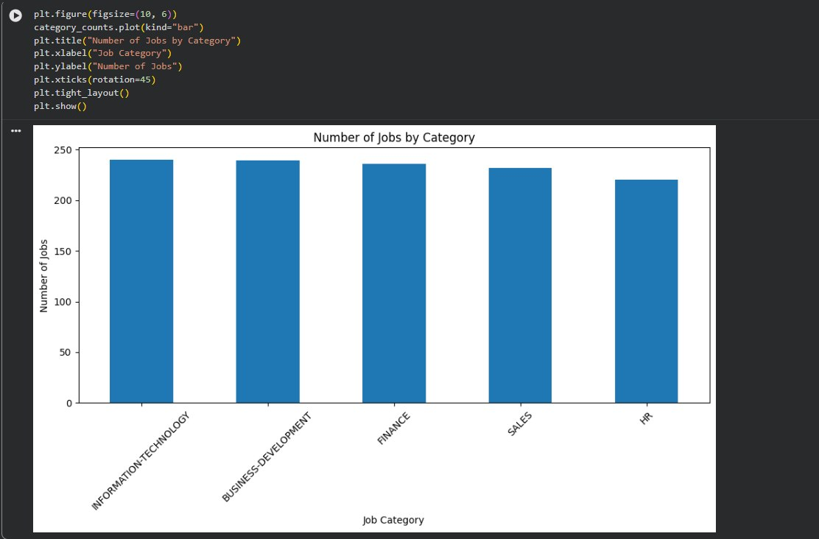
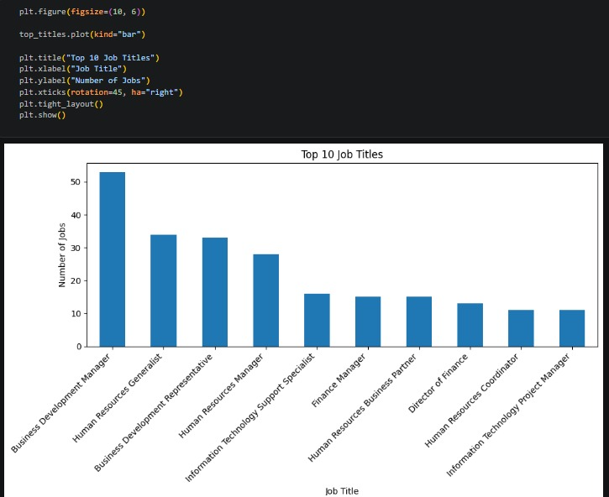
EDA

Slide 8
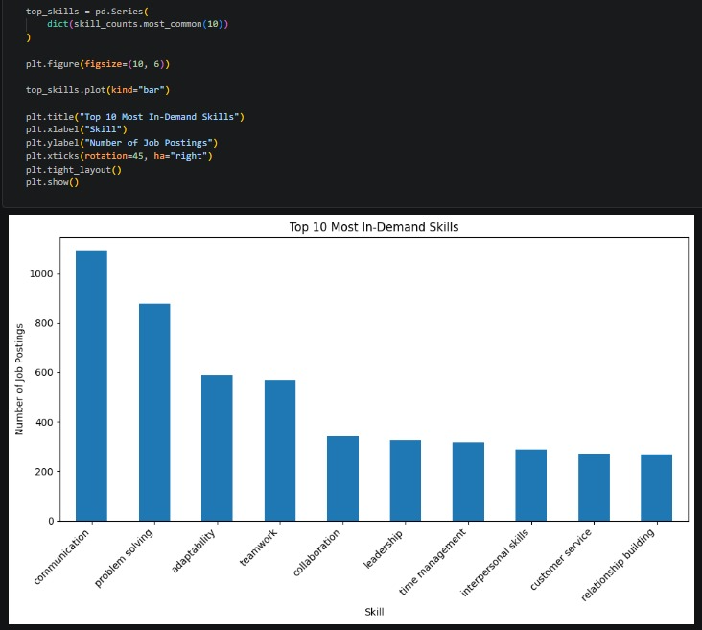
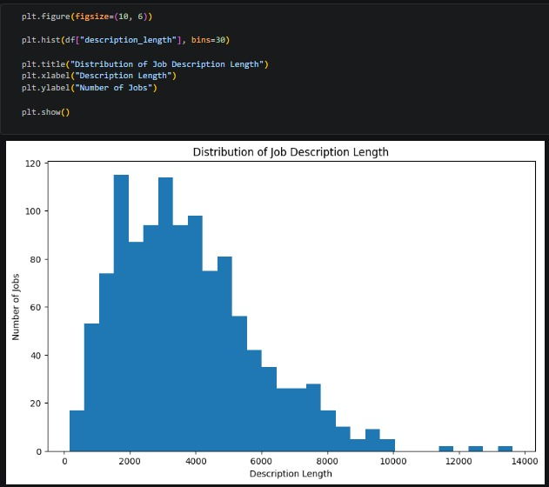

Slide 9
Methodology
1. Candidate Profile
Candidate provides information such as skills, education and experience.
2. Text Preprocessing
The textual data is cleaned and prepared for analysis.
3. TF-IDF
Text is converted into numerical feature vectors.
4. Cosine Similarity
Similarity between the candidate profile and each job is calculated.
5. Ranking
Jobs are arranged from highest to lowest similarity score.
6. Recommendation
The top-ranked jobs are presented as recommendations.
Candidate Profile
↓
Text Preprocessing
↓
TF-IDF Vectorization
↓
Vector Representation
↓
Cosine Similarity
↓
Similarity Score
↓
Ranking
↓
Recommended Jobs

Slide 10
Results
Rank | Recommended Job | Similarity Score
1 | VP / Client, Finance & Strategy Data Scientist | 17.94%
2 | Information Technology Specialist | 16.63%
3 | Data Solutions Analyst II... | 15.02%
4 | Information Technology Specialist | 14.71%
5 | Lead Software Engineer - Finance | 14.59%

Slide 11
Conclusion
The proposed Job Recommendation and Candidate Matching system demonstrates how Content-Based Filtering and Cosine Similarity can be used to identify suitable job opportunities for candidates. By comparing candidate profiles with job descriptions and calculating similarity scores, the system can rank jobs according to their relevance. This approach helps reduce the time and effort required for manual job searching and provides candidates with more relevant and personalized job recommendations.

Slide 12
Future Scope
The system can be further improved by adding resume upload functionality to automatically extract candidate information and skills. Advanced NLP and semantic models can be used to improve the accuracy of job matching. Location and experience-based matching can also be incorporated to provide more personalized recommendations. In the future, a complete web-based interface can be developed to allow users to enter their profiles, search for jobs, and receive real-time recommendations. A skill-gap analysis feature could also be added to identify the skills a candidate needs to develop for a particular job.

Slide 13
Thank you

